Slide 1
Into to The Library & Using Library Resources

Slide 2
Agenda for this Session
Connecting & Services
A few comments about research and getting started
Tips for developing a search strategy
Questions

Slide 3
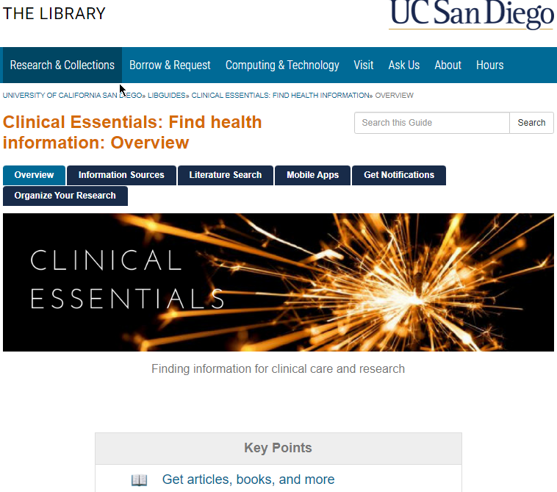
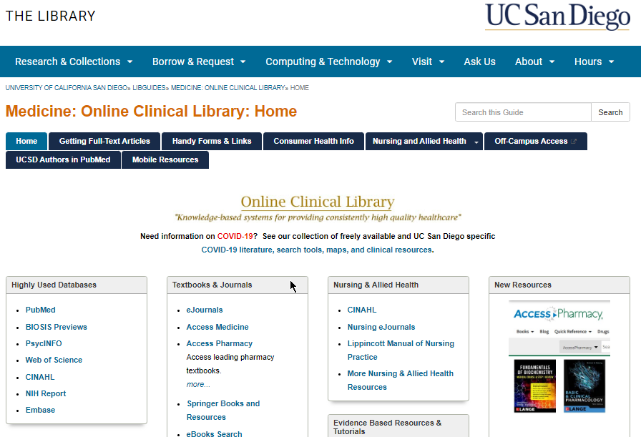
Clinical Essentials – https://ucsd.libguides.com/clinical
Online Clinical Library page – http://libguides.ucsd.edu/medicine
Resources to note:
Notes:
Clinical Essentials – notes and a few details
Online Clinical Library – just links

Slide 4
What if I Cannot Get the Article I Need?
Check your Connection:
Protected Network?
Remote? use the VPN

Slide 5
I’m Connected but
That Didn’t Work, What’s Next
Check UC Library Search
Title Search in GS
Use Interlibrary Loan
https://search-library.ucsd.edu/
Check “All # Versions”
https://search-library.ucsd.edu/

Slide 6
Librarians & Services
Jeffry Loo, Clinical Librarian
Karen Heskett, Medical Librarian
Stephanie Labou, Data Librarian
Research Data Curation Program
Connect with a librarian
All things clinical
For research or systematic reviews
Data services, data sets, coding workshops
Data management plans, data curation
Notes:
See the Online Clinical Library for contact info
http://libguides.ucsd.edu/medicine

Slide 7
Other Library Services
We are more than just books & journals

Slide 8
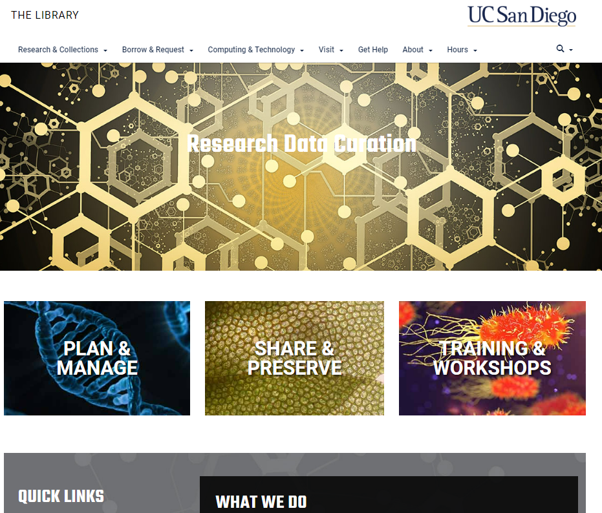
Research Data Curation
Notes:
Help with preserving (non-patient) data, tools to help you create data management plans (needed for grants)
https://library.ucsd.edu/research-and-collections/research-data/index.html

Slide 9
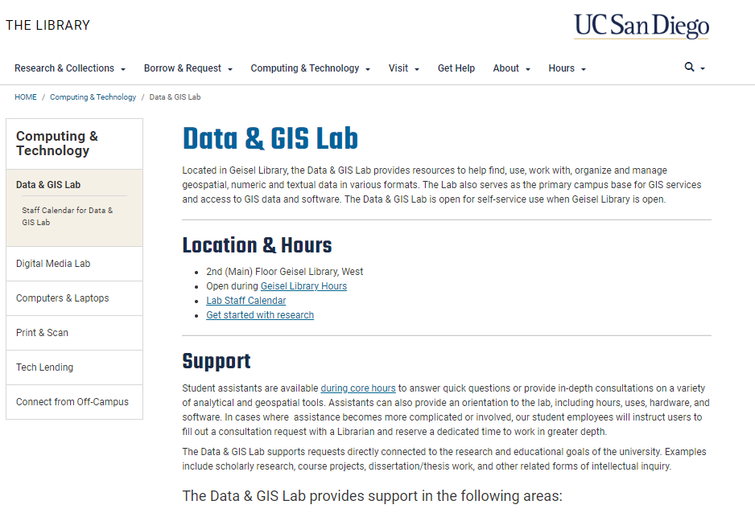
Data & GIS
Notes:
In the library – consultations on using the software and computers with available software – can register for remote/virtual computer access
https://library.ucsd.edu/computing-and-technology/data-and-gis-lab/index.html

Slide 10
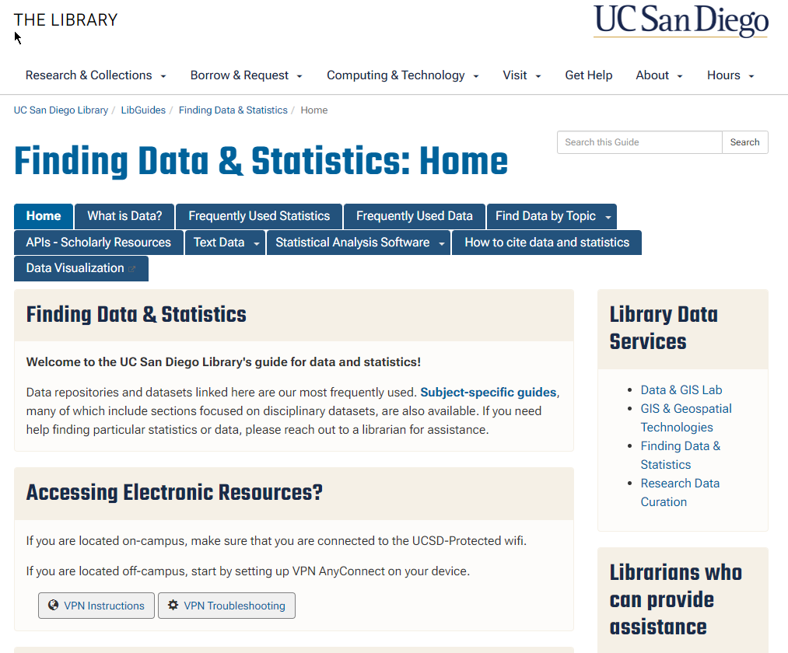
Data Resources
Notes:
What do we have? Give it a look to see if we have some tools to help you find the data or statistic you need.
https://ucsd.libguides.com/data-statistics

Slide 11
Search Strategies for
Different Needs

Slide 12
PubMed Tips
Browse: find a good article then find some additional articles with Similar Articles
Think like an author: set up a Title search for one or two words
Help PubMed find good stuff for you – don’t put in your whole research question, divide it into “chunks” using just the key aspects of your topic
Purpose: know what you need & use the tools (limits, MeSH) to help focus the search
Know your tool: what does it cover, not cover, how can you maximize your results

Slide 13
Purpose: Continuum of Research – Where Do You Fall?
Comprehensive
Retrieval
Limited
Retrieval
High Sensitivity:
find everything on your topic but lots of irrelevant ones
I need a robust search strategy and to use multiple resources
I want a few articles in support of a journal club activity
High Specificity:
highly relevant results but you miss some good articles

Slide 14
Possible Databases to Use
PubMed: medicine, health care, public health
Embase: similar to PubMed but can expand international coverage
CINAHL: nursing and allied health fields
PsycINFO: psychiatry, psychology, psychological aspects of health & medicine
ERIC: education related topics, from preschool to university
Family & Society Studies Worldwide: good for PH and social science – a small-ish database
Web of Science: all disciplines
Google Scholar: good for all disciplines

Slide 15
PubMed
Known as the “premier biomedical database”
Free for everyone to use
Link from the Online Clinical Library – puts in the Get It @ UC button

Slide 16

Get it at UC – Link to Full-Text Articles

Slide 17
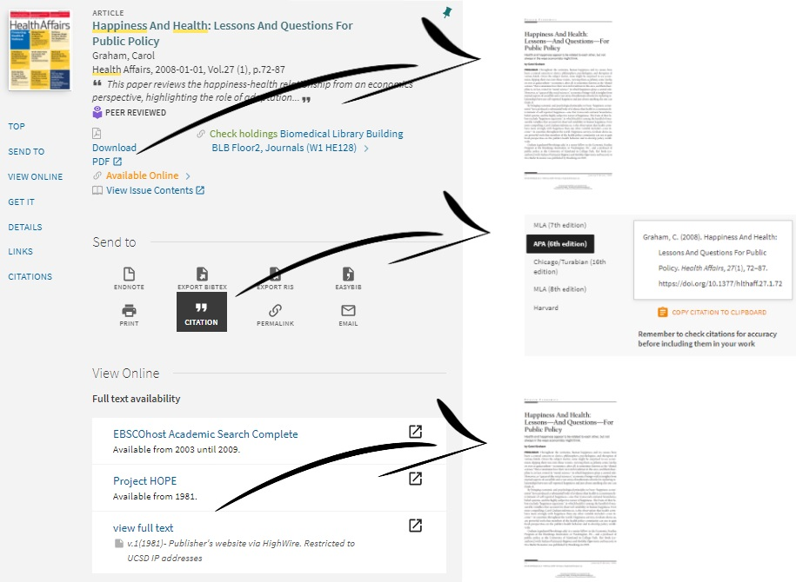

Slide 18
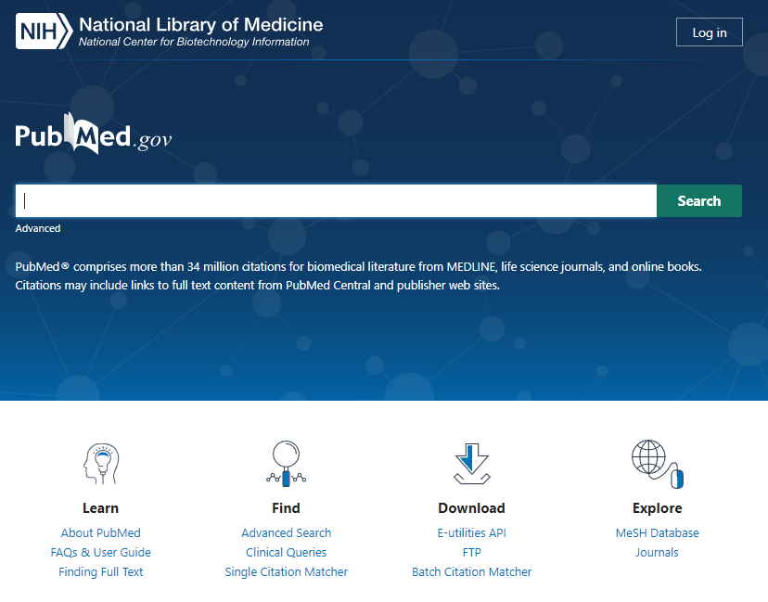
For Later: Reminders about PubMed Searching

Slide 19
Do I have to Use MeSH?
Maybe, it depends upon your purpose
  Are you okay letting PubMed handle that for you?
  Are you doing something systematic and need better reproducibility & transparency?
  Rare cases – would a Major MeSH heading help cut through to some highly relevant articles (knowing you might miss some relevant ones in favor of the highly relevant ones)?

Slide 20
Let’s Look at PubMed

Slide 21
Getting Organized:
Using Citation Management Tools

Slide 22
Managing Citations
UC Library Search citation tool
Some databases (including Google Scholar) have a “Cite It” tool
Other formatting tools: ZoteroBib, EasyBib, or other online tools
But wait, there are tools for that stuff …

Slide 23
Citation Management Tools
Endnote Desktop (current version is 21): $200+
Endnote Online: free, lots of citation styles with the UCSD version
Mendeley: free
Zotero: free
Caveat: the free tools have a maximum available space but Mendeley & Zotero offer more storage for a small monthly fee

Slide 24
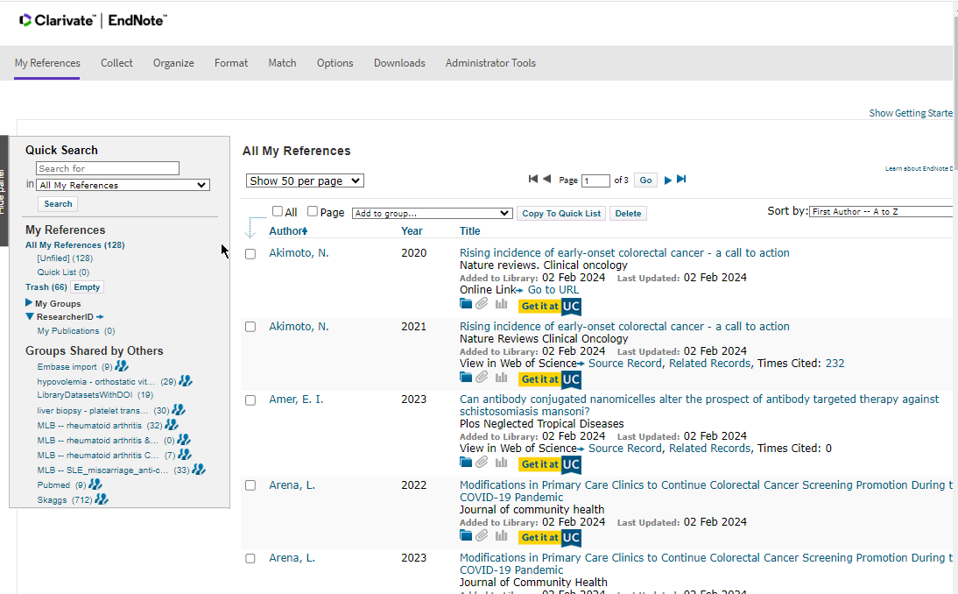
Endnote Online
Notes:
Sign up at: https://www.myendnoteweb.com/
While you can sign up with multiple emails, only one library is possible
Computer#2

Slide 25
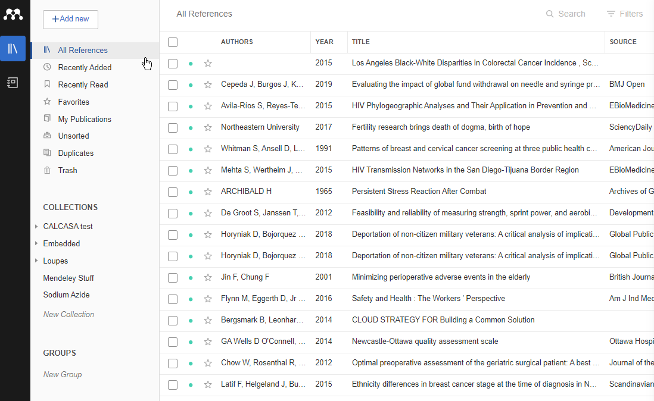
Mendeley
Notes:
Sign up at: https://www.mendeley.com/
Both web and a desktop version – this is the web version
While you can sign up with multiple emails, only one library is possible
computer#2

Slide 26
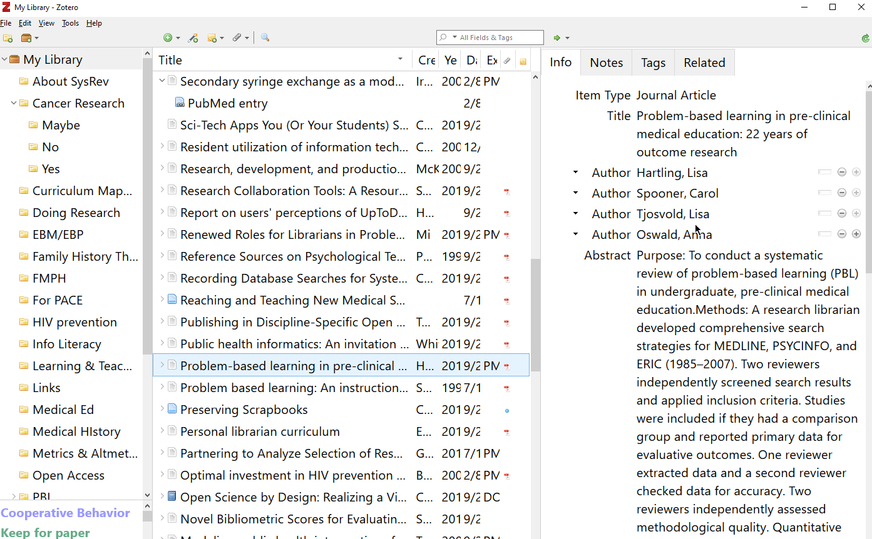
Zotero
Notes:
Sign up at: https://www.zotero.org/
Both web and a desktop version – this is the desktop version
While you can sign up with multiple emails, only one library is possible
omputer

Slide 27
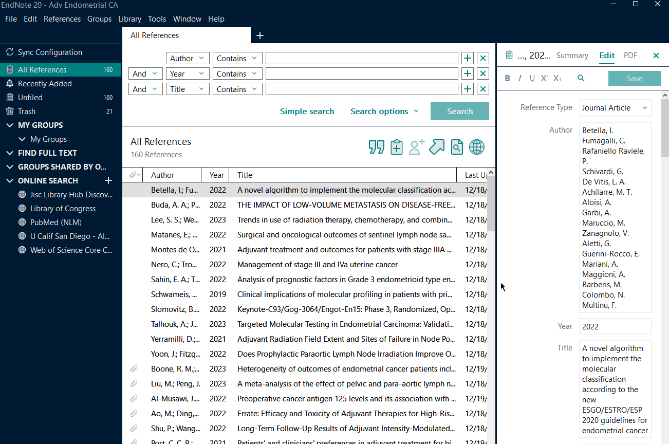
Endnote Desktop
Notes:
Sign up at: https://www.zotero.org/
Both web and a desktop version – this is the desktop version
Multiple libraries are possible - do not put in Dropbox or other cloud storage

Slide 28
Citation Mangers, What can it do for Me?
Go from a database, a web page, use a PDF, or sometimes use a DOI (or PMID) to add the details to your library.

Slide 29
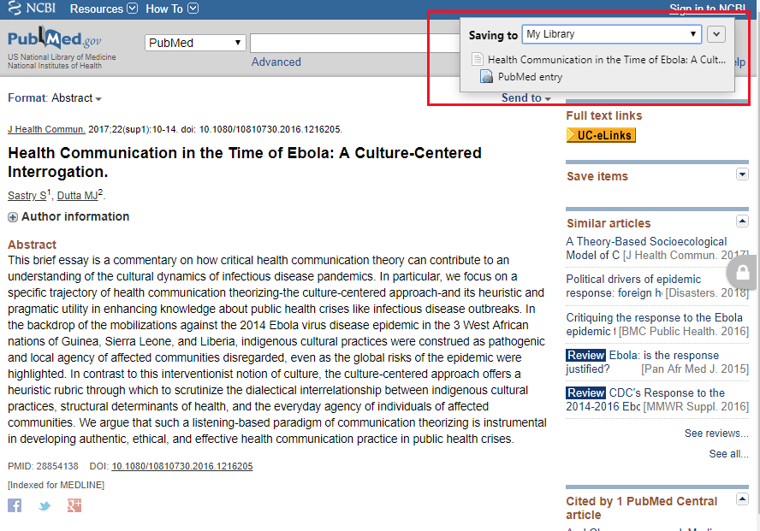

Slide 30
With a Couple of Clicks, Wind up with ...
Sastry, Shaunak, and Mohan J. Dutta. 2017. “Health Communication in the Time of Ebola: A Culture-Centered Interrogation.” Journal of Health Communication 22 (sup1): 10–14. https://doi.org/10.1080/10810730.2016.1216205.
No Retyping needed.

Slide 31

Questions?
Karen’s email kheskett@ucsd.edu Library’s Ask Us Service 24/7

