Slide 1
Journal Club
Kathryn Dere
Geriatric Medicine Fellow, UCSD

Slide 2
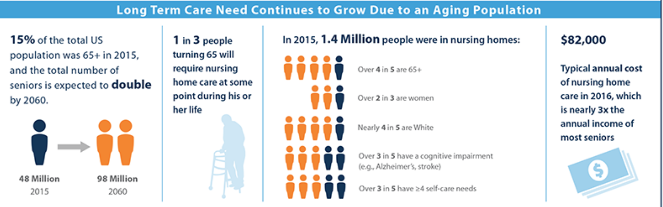
Background: nursing home population
https://www.kff.org/infographic/medicaids-role-in-nursing-home-care/
Notes:
Nursing home care and what it looks like.
In the US – huge population of older adults; more than 15%
1 in 3 people turning 65 will require nursing home care at some point in time during their life.
In 2015, 1.4 million people were in nursing homes. 80% were over the age of 65, more than 60% had a cognitive impairment, more than 60% had at least 4 self-care needs
Extremely vulnerable population;

Slide 3
Background: infections in the nursing home
Nearly 25% of the short-stay population returns to hospital for treatment of an infection
  325,000 hospital transfers
  Over $4 billion in additional annual health care costs
UTI's are leading cause of infection among nursing home residents
  Catheter-associated UTI's are a target for intervention: up to 13% of men and 12% of women have an indwelling urinary catheter on admission
Notes:
Infections are a major source of morbidity and mortality in NH's
Nearly 25% of the short-stay portion of SNF's return to the hospital for treatment of an infection – that's 325,00 hospital transfers a year, and more than $4 billion in additional health care costs.
Urinary tract infections are a leading cause of infection among nursing home residents; in particular, as we well know, catheter-associated urinary tract infections (CAUTI's) have often been targeted for intervention.
Up to 13% of patients have a urinary catheter upon admission to SNF

Slide 4
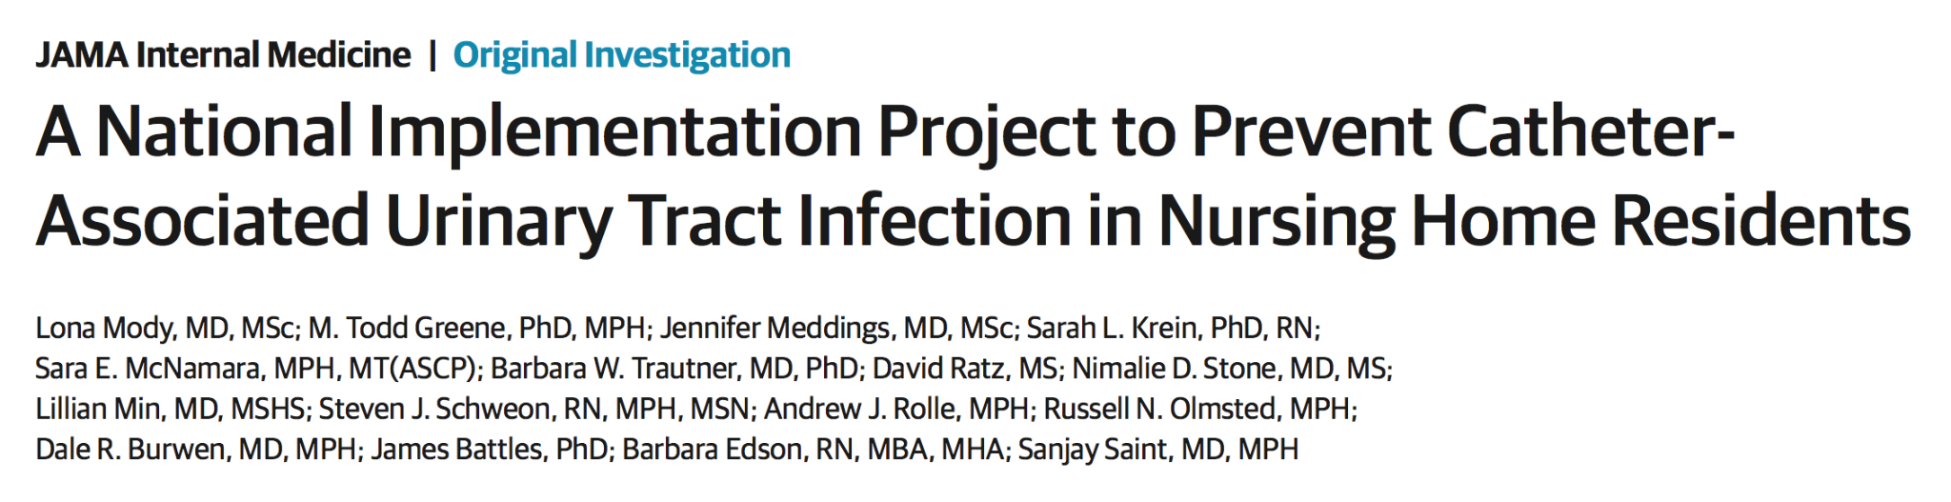
Mody L, Greene MT, Meddings J, Krein SL, McNamara SE, Trautner BW, Ratz D, Stone ND, Min L, Schweon SJ, Rolle AJ, Olmsted RN, Burwen DR, Battles J, Edson B, Saint S. A National Implementation Project to Prevent Catheter-Associated Urinary Tract Infection in Nursing Home Residents. JAMA Intern Med. 2017 Aug 1;177(8):1154-1162. doi: 10.1001/jamainternmed.2017.1689. PMID: 28525923; PMCID: PMC5710434.
Notes:
Article today from JAMA internal medicine 2017
I was initially interested in looking at management of catheters – specifically, how long can you really wait before changing a catheter, because I've found there are a lot of rules around that in SNF – but could not find a lot of evidence.
So this article was interesting to me because it took a step back and examined all the factors that we could adjust to decrease CAUTI's in nursing homes

Slide 5
Clinical question:
Population: nursing home
Intervention: educational
Comparison/control: none
Outcome: catheter-associated urinary tract infection (CAUTI) incidence
“Can a multicomponent initiative focusing on technical and socioadaptive interventions reduce catheter-associated urinary tract infection in nursing homes?”

Slide 6

How was this intervention developed?
Based on the AHRQ's Comprehensive Unit-Based Safety Program
  Original goal was to reduce CAUTI's in the hospital
Toolkit created with the help of subject matter experts from multiple organizations
  Health Research & Educational Trust
  University of Michigan
  Abt Associates
  Association of Professionals in Infection Control and Epidemiology
  Baylor College of Medicine
  Qualidigm
  Society of Hospital Medicine
https://pubmed.ncbi.nlm.nih.gov/27248619/
Notes:
Before we begin with the specifics of the study,
This study was part of a huge initiative by the government, the agency for healthcare research and quality
And it spun off from another initiative, the comprehensive unit-based safety program whose original goal was to reduce CAUTI's in the hospital. The goal of this project was to modify the elements from that program and enhance adoption of infection prevention practices in nursing homes
It comes with a very in-depth toolkit that can be accessed by anyone, and that toolkit was created with the help of subject matter experts from multiple organizations

Slide 7
Study design
“Large-scale prospective implementation project”
5 different cohorts between March 1, 2014 and August 31, 2016
Each cohort collected data over a 10-12 month implementation period
First cohort was a 10-month pilot, and not included in the analysis here
Notes:
This study is a little different than the others because it is actually an implementation project, which (NIH): studies "the use of strategies to adopt and integrate evidence-based health interventions into clinical and community settings in order to improve patient outcomes and benefit population health"
Each cohort had a 2-month long introduction/planning stage followed by a 10-12 month implementation period
Although there were 5 cohorts, this paper only delves into results from 4 of those cohorts, as the first cohort was a pilot

Slide 8
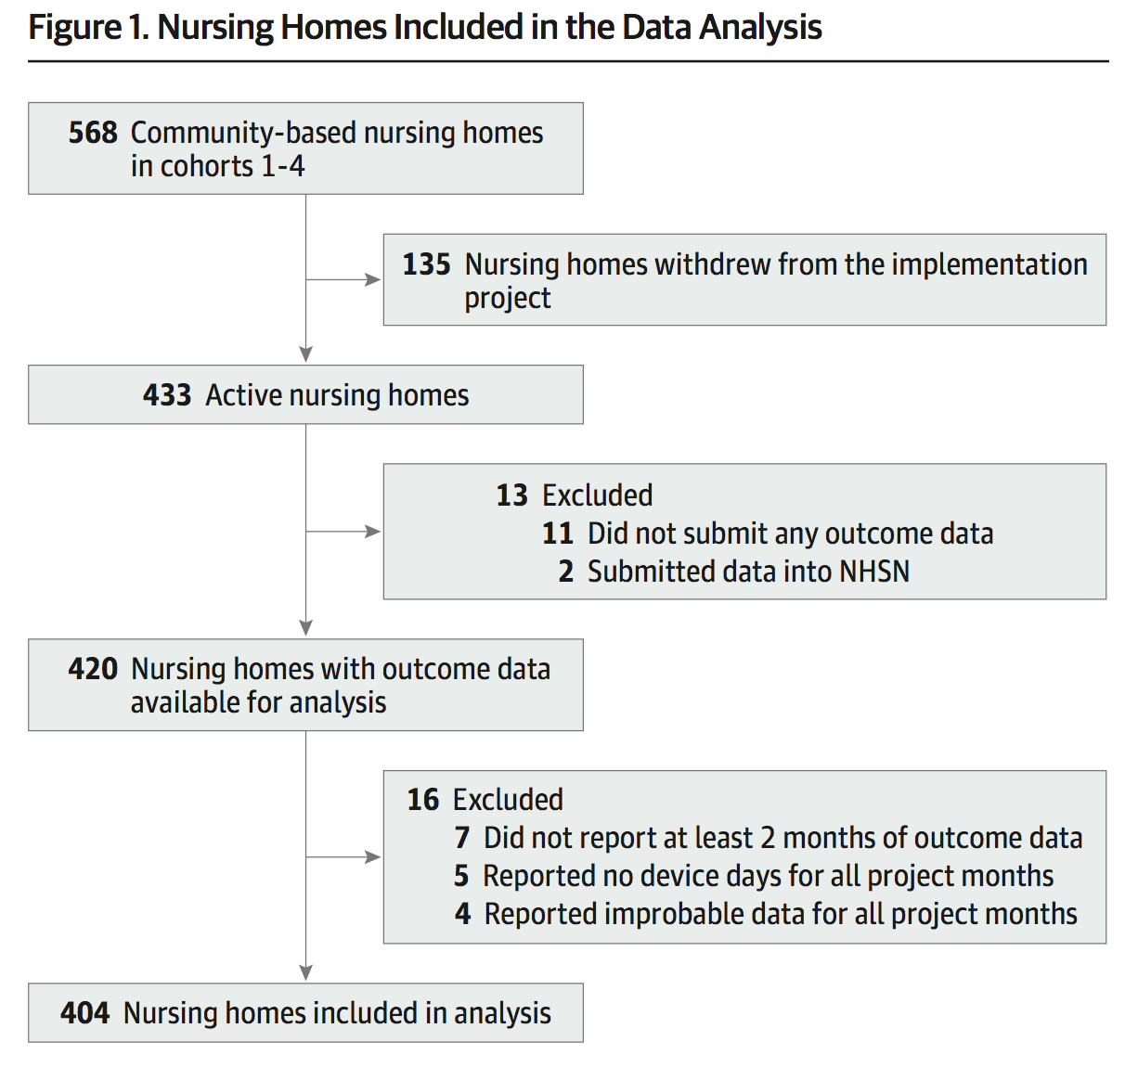
Study subjects
Community-based nursing homes
participating in the Agency for Healthcare Research and Quality Safety Program for Long-Term Care
in 48 states, Washington, DC, and Puerto Rico
Notes:
Subjects here are nursing homes, not necessarily people
The NH's had to be community-based and participating in the AHRQ's program for long-term care
And were recruited across 48 states, DC, and Puerto Rico
Initially 568 NH's were recruited; 433 completed the project; 404 were included in the analysis

Slide 9
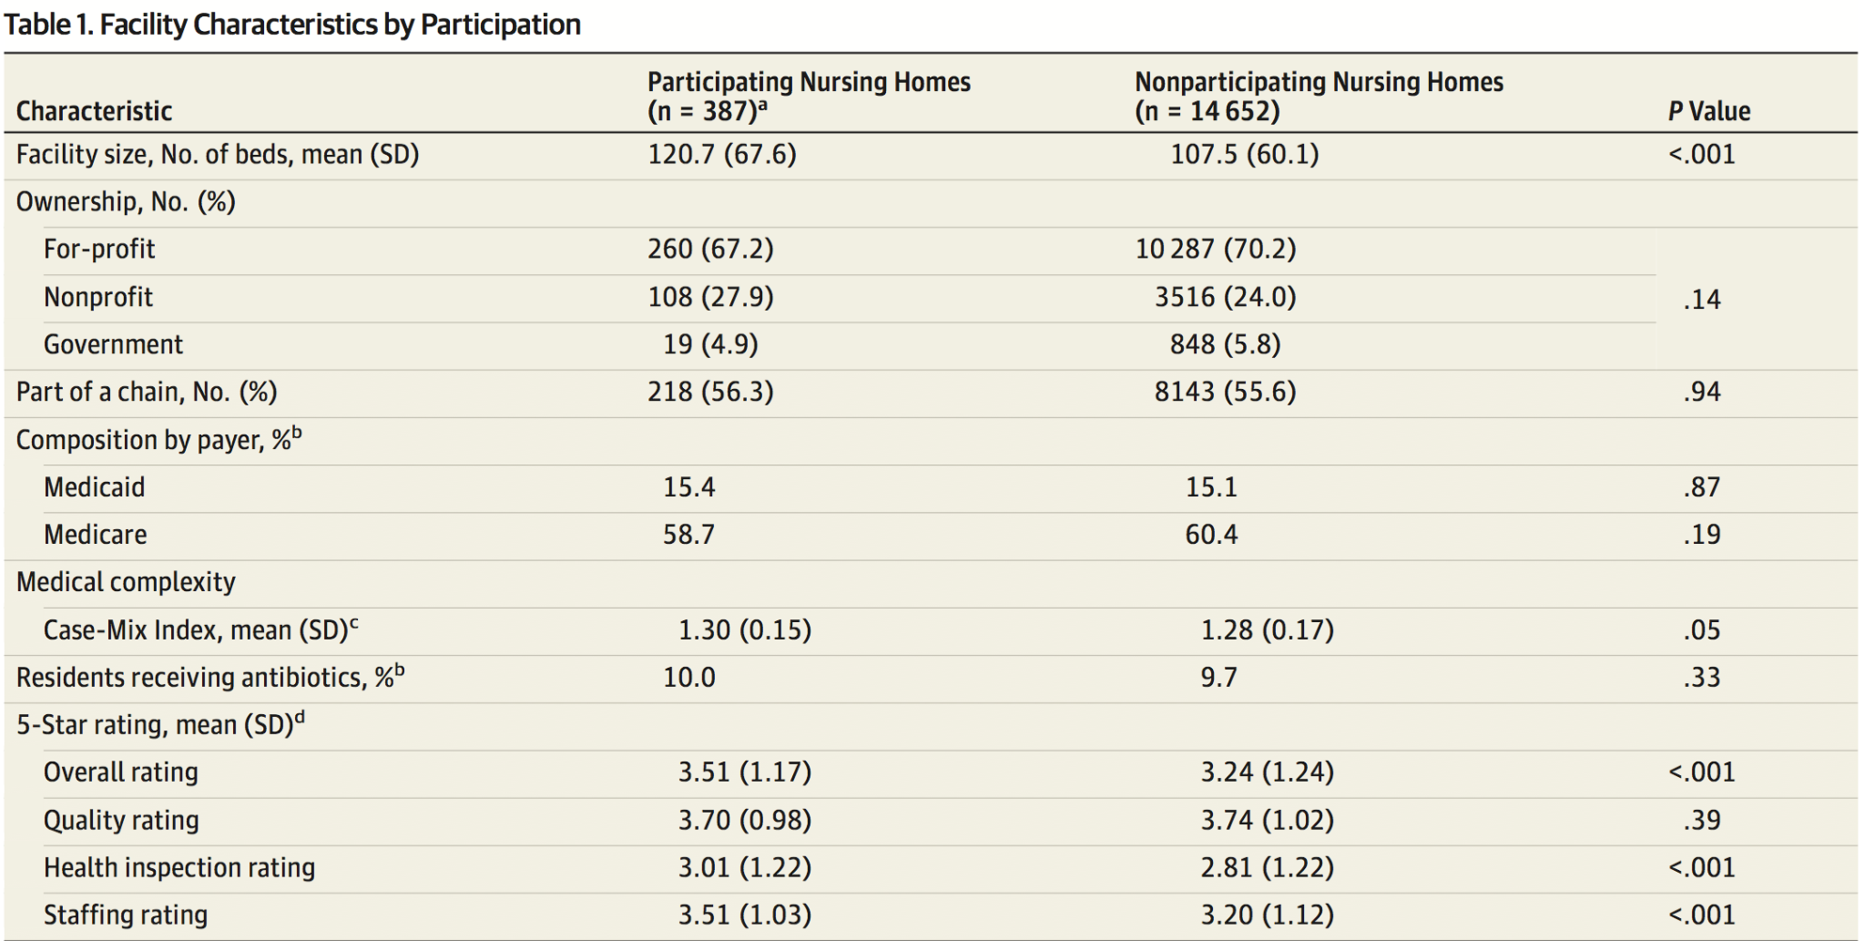
Notes:
Case mix index: Based on Medicare Diagnosis-related groups (DRG's), which are weighted by resource consumption
Higher CMI = higher complexity and resource intensive

Slide 11

What is the 5-star Quality Rating System?
Health inspection
  Based on nursing home surveys, complaint surveys, and survey revisits over the past 3 years
Quality measures (calculated from MDS data)
  Long-stay quality measures: ADL decline, mobility decline, catheter, high-risk pressure ulcers, physical restraints, urinary tract infections, moderate to severe pain
  Short-stay quality measures: pressure ulcers, moderate to severe pain, delirium
Staffing
  RN hours per resident day
  Total staffing hours (RN, LPN, nurse aide) per resident day
Notes:
Revisiting the 5-start rating:
-overall rating , health inspection rating, and staffing ratings were better in the study
-quality ratings were NOT significantly different (so, presumably similar rates of UTI's, catheter use)

Slide 12
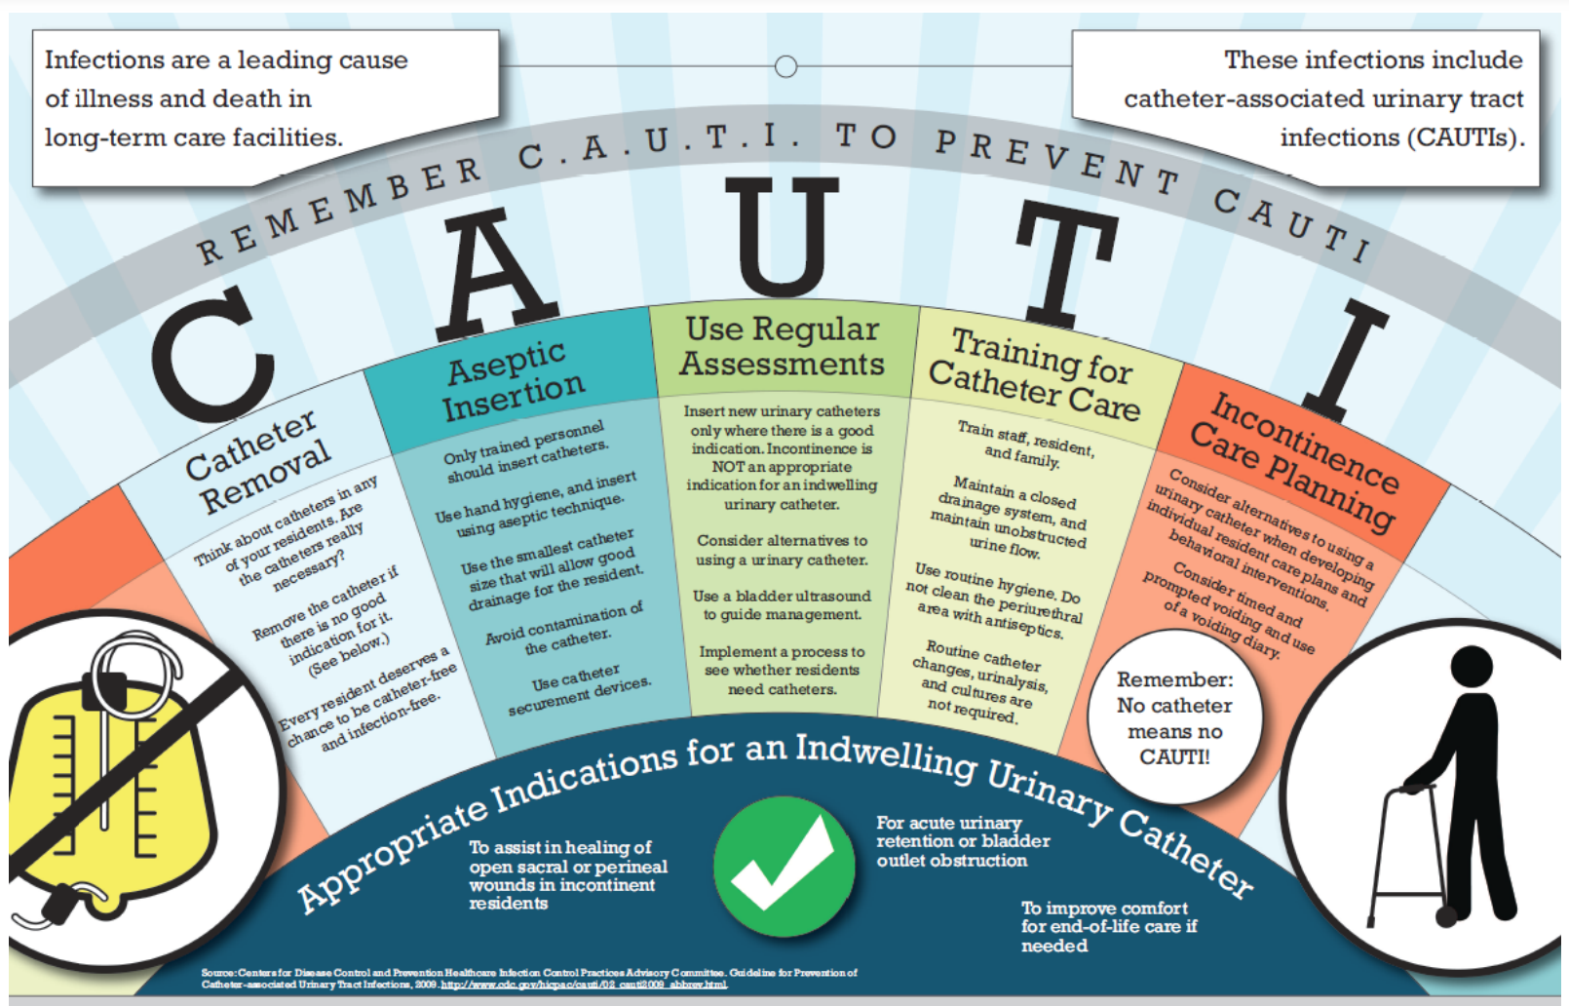
Interventions
Technical
Notes:
Interventions were all educational.
2 major categories of the education used.
Technical

Slide 13
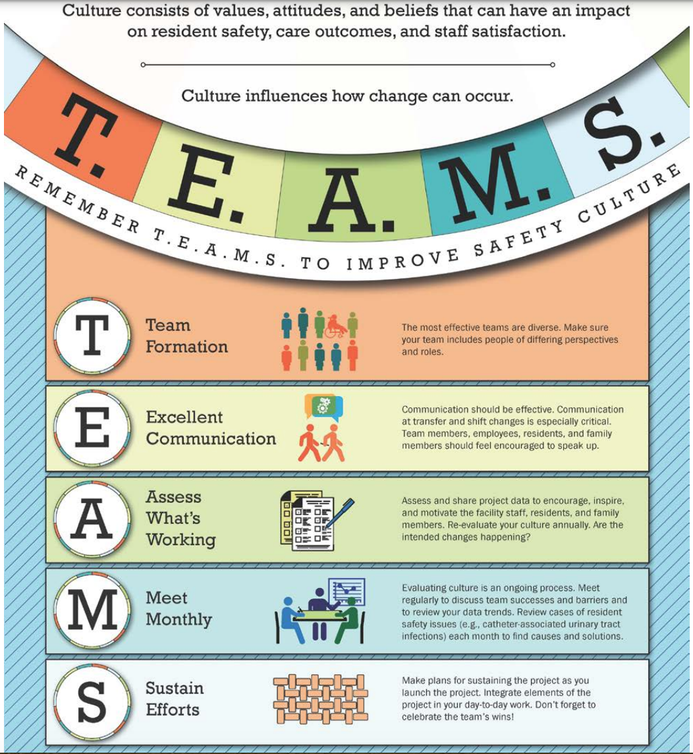
Interventions
Technical
Socioadaptive
Notes:
Socioadaptive intervention was also an educational intervention that focused on teamwork, safety culture, engaging all members of the care team plus the patients and their families – making sure people felt comfortable speaking up if they were concerned about safety, and how to address these issues
Socioadaptive:
-Creating safety teams
-Engaging leadership, frontline staff, residents, and family members
-Enhancing communication strategies pertinent to resident safety

Slide 14
Interventions
Three learning sessions per cohort – at beginning, middle, and end of project
Monthly coaching calls to review data, discuss project implementation, and share successes and barriers
Monthly webinars
Notes:
These interventions were very time intensive
Education on technical and socioadaptive bundles provided through learning sessions (in person or virtual), coaching calls, and webinars

Slide 15
Planning period
Intervention (10-12 months)
1 2 3 4 5 6 7 8 9 10 11 12 13 14
Learning session #1
Learning session #2
Learning session #3
MONTHLY CONTENT TRAINING
MONTHLY WEBINARS (ORGANIZATIONAL LEAD)
MONTHLY WEBINARS/COACHING CALLS (FACILITY TEAM)

Slide 16


Measurements and follow up
Data collected in aggregate every month for 12 months
Primary outcome: CAUTI¹ incidence rate
Secondary outcome: urinary catheter utilization ratio
Objective process measure: number of urine cultures ordered
¹https://www.ahrq.gov/hai/quality/tools/cauti-ltc/modules/resources/tools/cauti-surveillance/pocket-card.html
Notes:
Use the CAUTI incidence rate because through the CDC's National Healthcare Safety Network, there is a protocol for tracking infections in long-term care facilities; and this is the definition they use (cauti episodes/cather days x 1000)
Process measures: These measures are the specific steps in a process that lead — either positively or negatively — to a particular outcome metric
Unlike clinical definitions that rely on physician diagnosis and antibiotic prescribing, NHSN surveillance criteria incorporate objective systemic and localizing clinical findings with laboratory- based criteria to define catheter-associated UTI

Slide 17
Analysis
Multilevel mixed-effects negative binomial regression.
A negative binomial regression is:
Used for modeling counts (whole numbers ≥0)
  In this case, CAUTI rates, catheter utilization rates, and urine cultures ordered
Like Poisson regression, but can be more realistic
  Poisson: use when variance = mean
  Negative binomial regression: can use when variance ≠ mean
Notes:
Also adjusted for covariates including ownership, bed size, provision of subacute care, 5-star rating, presence of an infection control committee, and an infection preventionist

Slide 18
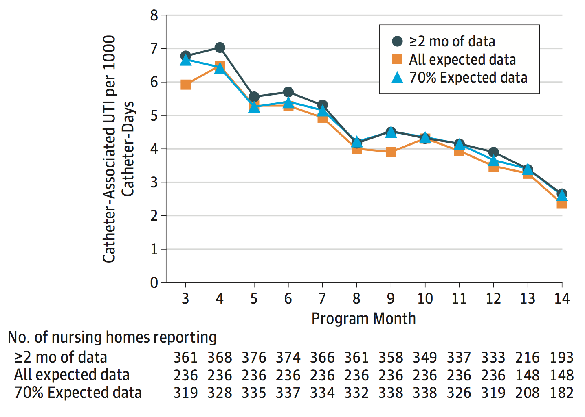
Results
Reduction in CAUTI rates by 54% over the 12-month period
  75% of facilities showed a reduction of 40% or more
No change in catheter utilization
Reduction in the frequency of orders for urine cultures
Notes:
After adjustment for facility characteristics, the incidence of catheter-associated UTIs was reduced from 6.42 to 3.33 per 1000 catheter-days (IRR, 0.46; 95% CI, 0.36-0.58; P < .001)
After adjustment, catheter utilization remained steady, with rates of 4.50 at baseline and 4.45 at the end of the project (IRR, 0.95; 95% CI, 0.88-1.03; P = .26)
Urine culture order rates, after adjusting for facility characteristics, decreased from 3.49 urine cultures per 1000 resident- days at the beginning of the project to 3.08 urine cultures per 1000 resident-days at the end of the project. The results were similar in our adjusted model, with urine culture rates decreasing from 3.52 to 3.09 (IRR, 0.85; 95% CI, 0.77-0.94; P = .001).

Slide 19
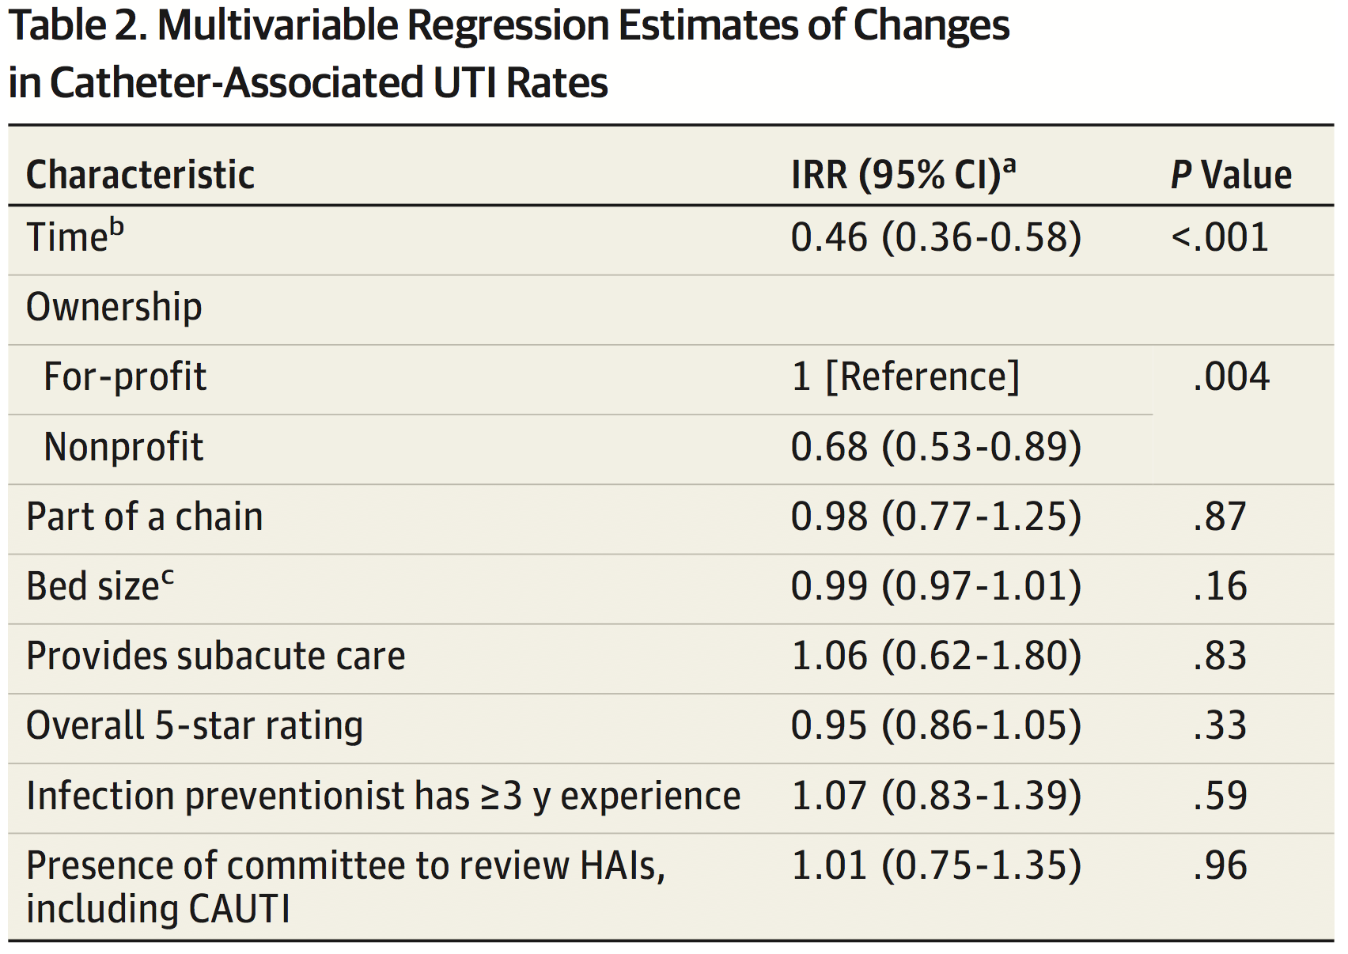
Results
Time was the only variable that significant affected CAUTI rates

Slide 20

Critique...

Slide 21
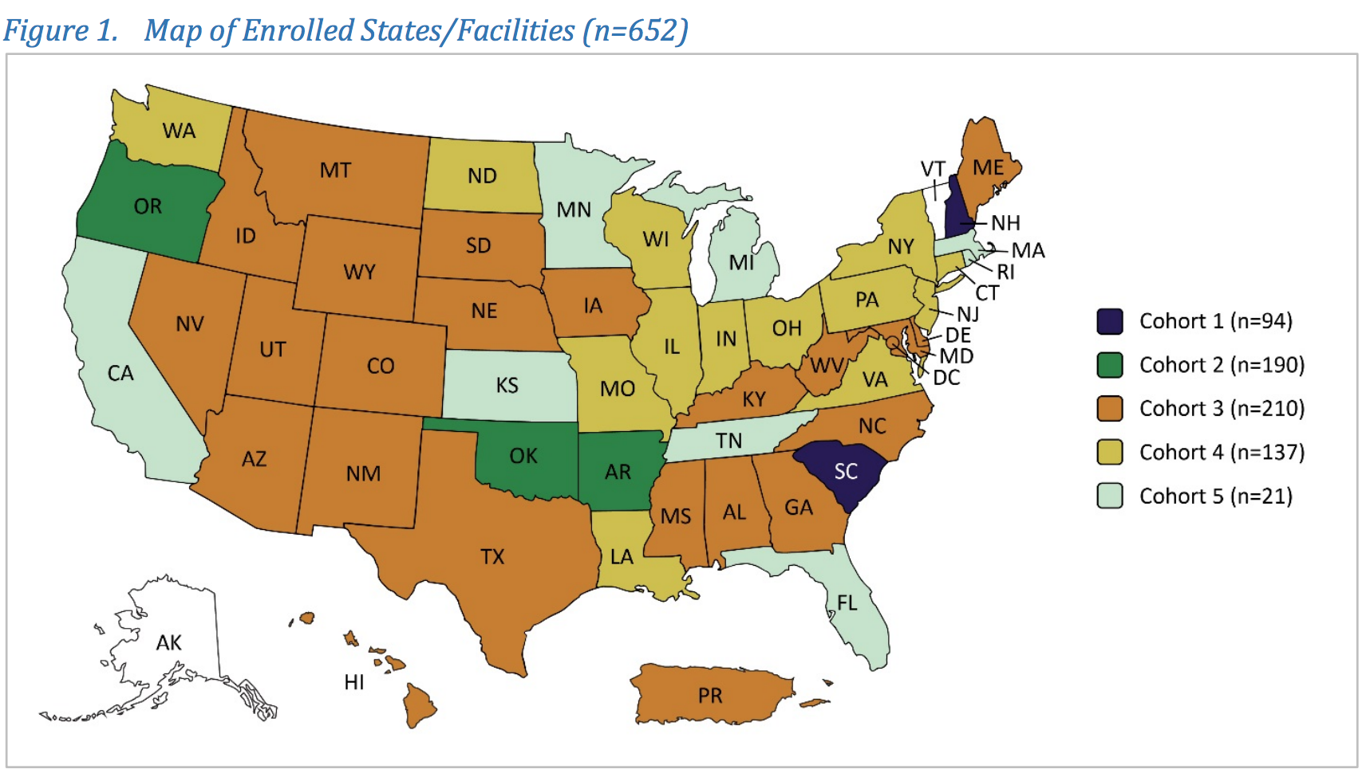
Strengths
Study size
Consistent results across many SNFs
Notes:
results appear consistent across so many SNFs across the US
Also, low-tech intervention – back to basics

Slide 22
Limitations
No direct comparison group in the study

Slide 23
Limitations
No direct comparison group in the study
SNFs in the study may not be representative of all SNFs
Notes:
SNFs in this study, although geographically diverse, may not be representative of all SNFs. Especially since the SNFs had to volunteer to participate
In the study (387)
Not in the study (14,652)

Slide 24
Limitations
No direct comparison group in the study
SNFs in the study may not be representative of all SNFs
Is this feasible and/or sustainable?
Most frequently cited reasons for withdrawal from the project:
  Time constraints and other competing priorities (n=65)
  Staff turnover and shortages (n=54)

Slide 25
Planning period
Intervention (10-12 months)
1 2 3 4 5 6 7 8 9 10 11 12 13 14
Learning session #1
Learning session #2
Learning session #3
MONTHLY CONTENT TRAINING
MONTHLY WEBINARS (ORGANIZATIONAL LEAD)
MONTHLY WEBINARS/COACHING CALLS (FACILITY TEAM)

Slide 26
Limitations
No direct comparison group in the study
SNFs in the study may not be representative of all SNFs
Is this feasible and/or sustainable?
Which interventions worked?
This study implemented a number of interventions, all at the same time: is there a way to scale down the interventions, and still have a positive effect on CAUTI rates?

Slide 27
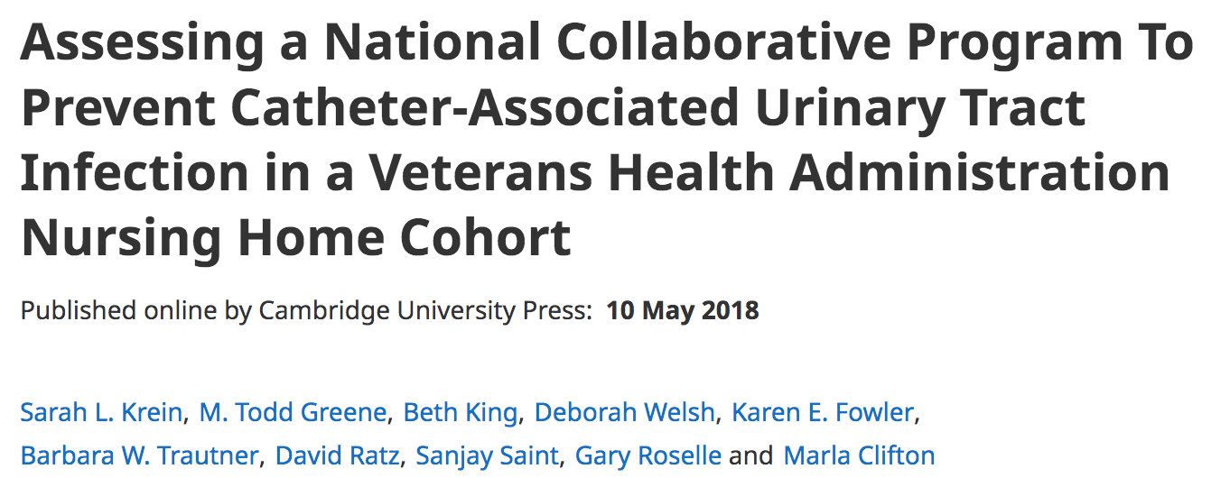
Application to other settings...
“No changes in CAUTI rates, catheter use, or urine culture orders were found during the program period. One potential reason was the relatively low baseline CAUTI rate, as compared with a cohort of community-based nursing homes. This low baseline rate is likely related to the VHA’s prior CAUTI prevention efforts.”
Notes:
https://www.cambridge.org/core/journals/infection-control-and-hospital-epidemiology/article/abs/assessing-a-national-collaborative-program-to-prevent-catheterassociated-urinary-tract-infection-in-a-veterans-health-administration-nursing-home-cohort/B7EF57D22698B95D2F9F9F4D6348CA80

