Slide 1
Introduction to journal club
UCSD Geriatric Medicine & Psychiatry Fellowships
Gerontology Research Collaborative (GRC)
Benjamin Han, MD MPH
Department of Medicine, Division of Geriatrics, Gerontology, and Palliative Care

Slide 2
UCSD Geriatric Medicine & Psychiatry Fellowships
Gerontology Research Collaborative (GRC)
Geriatric Medicine Fellowship
Geriatric Psychiatry Fellowship
San Diego area research institutions:
- UCSD, Salk, SDSU
  Meetings held every fourth Friday of the month from 3:30-4:30PM

Slide 3
Goals for Journal Club for Fellows
Learn the skills of evidence-based medicine and practice: interpreting findings presented in the medical literature. Be comfortable in researching a clinical question.
Learn about advances in medical knowledge that could or should change our clinical practice in geriatrics.
Gain familiarity with basic statistical methods.
Gain insight into a specific clinical problem.
Understand the limitation of the application of evidence.
Improve oral presentation skills.

Slide 4
Applying the evidence-base for our older patients
  Clinical trials often exclude older adults or adults with multiple chronic conditions.
  What outcomes are important for our older patients:
    Mortality vs. Quality of life, Function
    Clinical relevance of outcomes
  Harms and risks.
    Competing Risks
  Health disparities in clinical research.

Slide 5
Goals for Journal Club
Bring together a community of clinicians and researchers in the field of aging to think critically about an article to develop a broad yet deep understanding of aging-related research.
Facilitate better knowledge awareness through collaborative interdisciplinary group discussion.
Promote interest in research while learning from experts about knowledge gaps, future research questions, and the translation of research into clinical practice.
Foster collaborations across fields within aging.

Slide 6
Expectations for Journal Club
You have been assigned a date for when you will present two journal club presentations.
Your presentation will be done in Powerpoint, organized, and well-prepared.
Aim to complete your presentation within 25 minutes so there will be time for discussion.
Your presentation will be evaluated by journal club participants.

Slide 7
Expectations for Journal Club
You have been assigned a mentor who will supervise your preparation for journal club (Dr. Kohn or Dr. Han).
You must initiate discussion with your mentor at least 4 weeks prior to the journal club.
You and your mentor should have selected an article at least 2 weeks prior.
You must have a draft of your slides 1 week prior for review by your mentor.
You will send Dr. Han and Laura the article you have selected no later than Monday 5pm the week before your presentation so that the article can be disseminated to the division.

Slide 8
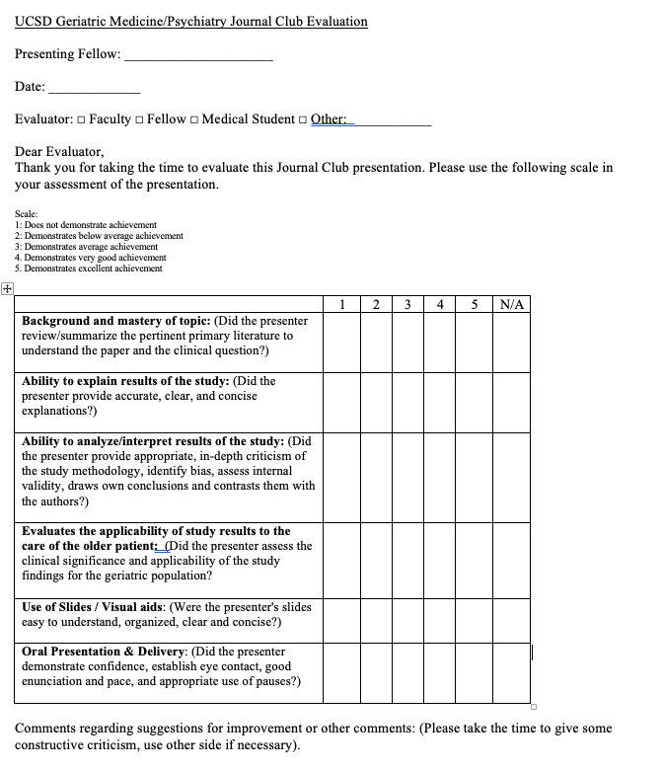
Evaluation and Feedback

Slide 9
How to use the medical literature
  Need to be alert to important new evidence. McMaster’s Evidence Alerts, ACP Journal Club, NEJM Journal Watch
  You need to problem solve for your patients.
  Asking background and foreground questions:
    Background questions: (usually medical student level, asking about pathophysiology).
    Foreground questions: They are questions asked when browsing the literature (i.e. what important new information should I know to optimally treat my patients?) or when problem solving (i.e. defining specific questions raised in caring for patients and then consulting the literature to resolve these problems).

Slide 10
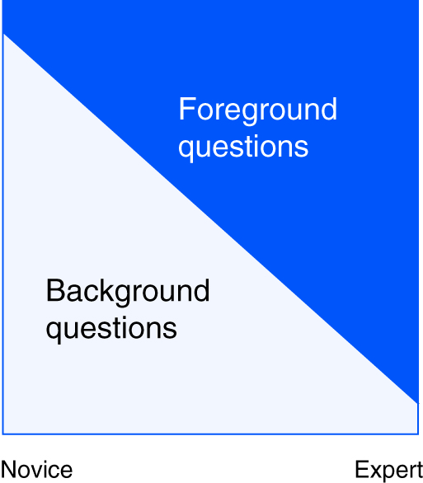
Question types
Background questions
  About conditions
  Foreground questions
  About choices

Slide 11
What is the question?
  On average clinicians have 5-8 questions about individual patients during caring for patients in primary care (Green et al., 2000; Gonzalez et al; 2007).
  Framing Clinical Questions: PICO
    Patients or Population: Who are the relevant patients?
    Intervention(s) or Exposure(s): For example, diagnostic tests, foods, drugs, surgical procedures, time, or risk factors. What are the management strategies we are interested in comparing or the potentially harmful exposures about which we are concerned?
    Comparator: For issues of therapy, prevention, or harm, there will always be both an experimental intervention or putative harmful exposure and a control, alternative, or comparison intervention or state to which it is compared.
    Outcome: What are the patient-relevant consequences of the exposures in which we are interested? We may also be interested in the consequences to society, including cost or resource use. It may also be important to specify the period of interest.

Slide 12
How to select an article
Select an article as a result of a clinical encounter.
Select an article that may change the audience’s clinical practice.
Geriatric-focused or relevant.
Try and select studies that are recent advances in the field (within the past two years) or the current best evidence, even if not recent (classic geriatric papers).

Slide 13
How to select an article
Select an article from a respected journal.
Examples include Journal of the American Geriatric Society (JAGS), The Gerontologist, The Journals of Gerontology: Series A, Annals of Internal Medicine, BMJ, JAMA, JAMA Internal Medicine, JAMA Psychiatry, The American Journal of Geriatric Psychiatry, The Lancet, Age and Ageing, and the New England Journal of Medicine.
Selected article s should report original research.
Do not select narrative reviews.

Slide 14
Journal club format

Slide 15
Journal club format

Slide 16
Journal club format
Background/Introduction/Context (~3-5 slides)
Start your presentation with a brief case presentation or briefly explain how the article is relevant to a patient or problem that you have encountered.
Brief summary of the existing knowledge, show key studies to date in this area. It helps to show summary slides (e.g. a recent meta-analyses).
Key relevant mechanistic or pathophysiologic issues.

Slide 17
Journal club format
II. Research Question/Hypothesis of the study (1 slide)
Describe the research question.
  Population, Intervention (or exposure), Comparison or control, Outcome
  Example - Over a 1-year period, does digoxin reduce hospitalization among older adults with congestive heart failure compared to placebo?

Slide 18
Journal club format
III. Study Design (1 slide)
What type of study is this?
  Randomized controlled, cohort, cross-sectional, case-control.

Slide 19
Journal club format
IV. Study Subjects (1 slide)
Who was in the study?
How were they selected? Sampled?
Who was excluded?
How many subjects were there?
Think critically about generalizability.

Slide 20
Journal club format
V. Measurements and follow up (1 slide)
Predictor variables:
  What are the independent variables?
  How are the variables measured?
Outcome variables (primary, secondary, etc):
  What are they? Are they clinically significant?
  How are they measured?
Follow up: how often and how long.

Slide 21
Journal club format
VI. Analysis (1 slide)
Describe the analysis of the study i.e. logistic regression, intent-to-treat, etc.

Slide 22
Journal club format
VII. Summarize the results (1 slide)
It is helpful to highlight a particular row on a table or to a particular part of a graph to illustrate your point.
The audience will have a copy of the article to follow along.

Slide 23
Journal club format
VIII. Your Critique (3-5 slides)
What are the possible biases? Consider its possible direction, magnitude, and impact.
Strengths, weaknesses, discussion points.
Describe why you think the results can or cannot be applied to your patients.
Conclude with your own decision about the utility of the study in your practice.

Slide 24
Applying the evidence-base for our older patients
  Clinical trials often exclude older adults or adults with multiple chronic conditions.
  What outcomes are important for our older patients:
    Mortality vs. Quality of life, Function
    Clinical relevance of outcomes
  Harms and risks.
    Competing Risks
  Health disparities in clinical research.

Slide 25
Journal club format
For clinical trials, look up if the trial was listed at the http://clinicaltrials.gov/ website, with special attention to revisions from originally stated endpoints, methods and inclusion criteria.
Check the PubMed listing of the original article to see if there are any other publications that are linked to the original article. Typically, these are editorials, letters to the editor, or listings in ACP Journal Club, all of which are helpful in getting a quick sense on the topic and finding out about any known issues regarding the study that have been discussed elsewhere.

Slide 26
Resources
Choosing an article can be challenging.
Your faculty mentors are here to help in selecting an appropriate article, preparing journal club, and feedback on presentation skills.
Online resources:
  https://jamanetwork.com/collections/44069/users-guide-to-the-medical-literature
  ACP Journal Club: https://www.acpjournals.org/topic/category/journal-club

Slide 27
Contacts:
Jordan Kohn, PhD
jokohn@health.ucsd.edu
Benjamin Han, MD
b2han@health.ucsd.edu

