Slide 1
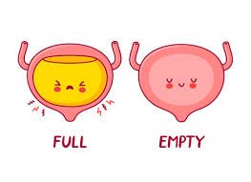
Urinary Incontinence
Daney Lozano

Slide 2
Epidemiology
Prevalence increases with age,15-30% all adults ≥ 65
Daily incontinence reported 12.2% in women 60 to 64 years, 20.9% in women 85 years old or older (1)
Daily urinary incontinence in mеn older than 65 years ranges from 2 to 11% (2)
Urinary incontinence is associated a 20 percent increased risk of death (hazard ratio [HR] 1.20, 95% CI 1.12-1.28, six cohort studies, 1656 participants) (3)

Slide 3
Impact of UI on Health
Quality of life: associated with depression/anxiety, work impairment, disability, social isolation
Sexual dysfunction: incontinence-related sexual dysfunction
Increased caregiver burden: decreased ability to perform ADLs
Higher risk of institutionalization (60-70% institutionalized pts)
Comorbidities: dermatitis, perineal infections (yeast infections, cellulitis), wounds/ pressure ulcers, falls

Slide 4
Types of Incontinence
Stress: involuntary leakage of urine that occurs with increases in intra-abdominal pressure (eg, with exertion, sneezing, coughing, laughing) in the absence of a bladder contraction
  Men: Prostate surgery, radiation, urethral trauma
  Women: urethral hypermobility, sphincter deficiency (loss of pelvic floor muscles)
Urge/Overactive bladder: manifests as a sudden and compelling desire to pass urine that is difficult to defer and is accompanied by involuntary leakage.
Mixed: Symptoms of both stress and mixed
Overflow: continuous urinary leakage or dribbling in the setting of incomplete bladder emptying– from BOO or impaired bladder contractions (detrusor underactivity)
  Men: BPH, strictures
  Women: fibroids or pelvic organ prolapse or hx surgery

Slide 5
Evaluation
Screening: all patients, as underreporting is common
History: classify incontinence, impact on QOL, systemic sx
Red flag sx: abrupt onset, pelvic pain, hematuria, new neurologic symptoms
Exam: pelvic exam
Test: UA to rule out UTI
Other testing
  PVR evaluate for urinary retention/overflow UI (>200 ml suggests overflow)
  Cough stress test
  Urodynamic testing
Voiding diaries – fluid intake and voiding is recorded. Helpful to assess severity and impact of treatment
Medication history: discontinuing causative agents

Slide 6
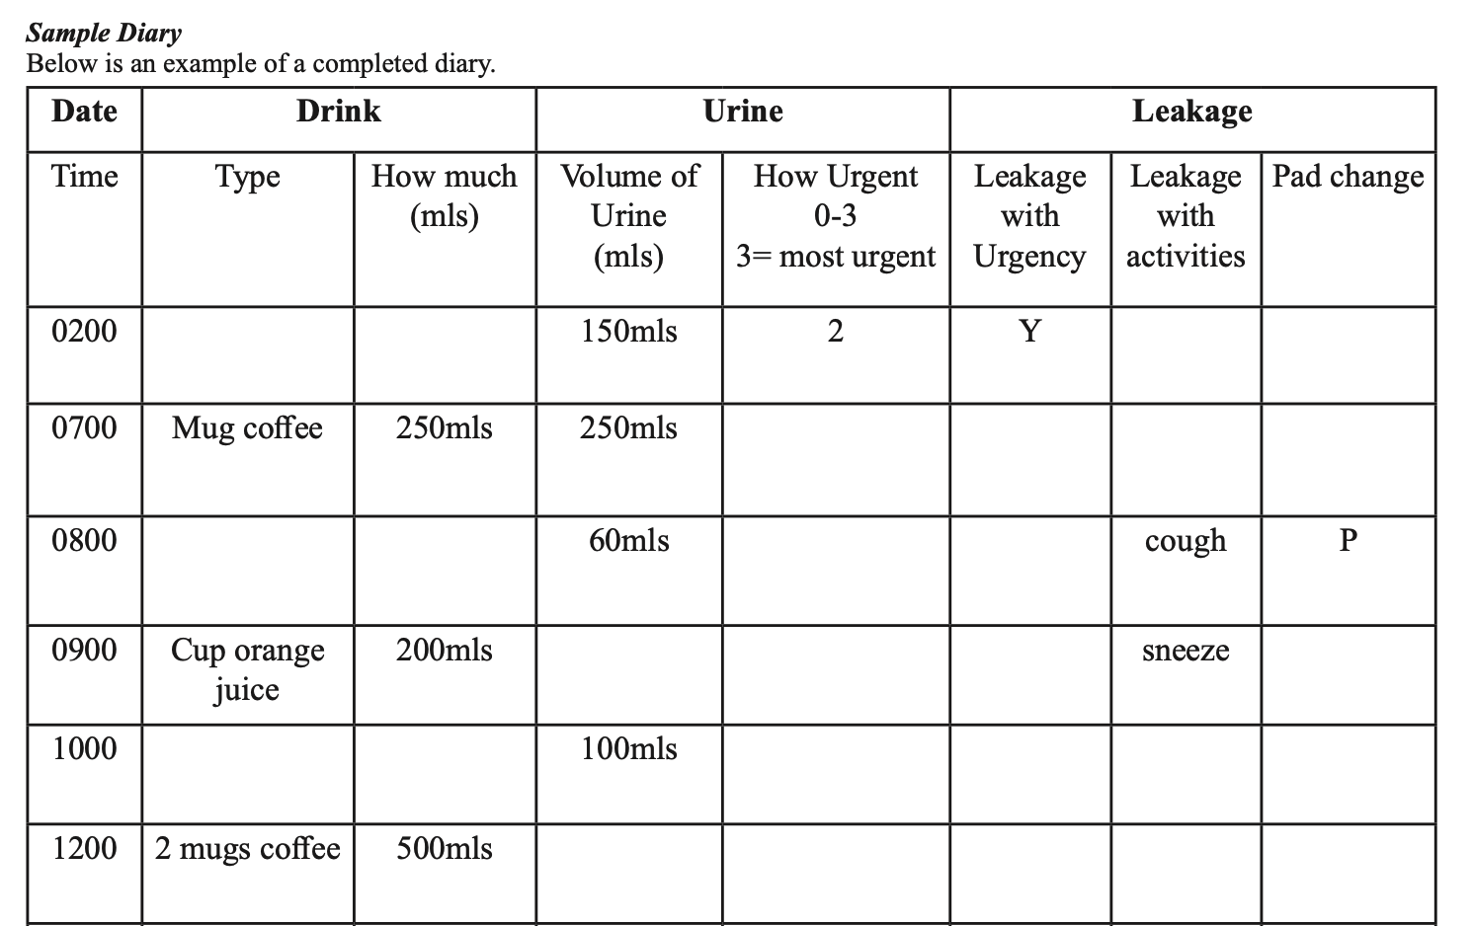
Voiding Diary (sample from IUGA)
https://www.yourpelvicfloor.org/media/Bladder_Diary-5.pdf

Slide 7
Causative Medications
Category | Examples | Possible effect on continence
Alpha agonists | Midodrine, phenylephrine, vasopressors (various) | Increased urethral sphincter tone / BOO (men)
Alpha blockers | Alfuzosin, doxazosin, prazosin, silodosin, tamsulosin, terazosin | Decreased urethral sphincter tone / (SUI in women)
ACE i | Enalapril, lisinopril, ramipril, others | Decreased bladder contractility; chronic cough
Antimuscarinics | Darifenacin, fesoterodine, oxybutynin, solifenacin, tolterodine, trospium | ↓ contractility via anticholinergic effects, retention, delirium, sedation, fecal impaction
Antihistamines | Diphenhydramine, hydroxyzine, cyproheptadine | ↓ contractility via anticholinergic effects
Anticholinergics (Parkinsons meds) | Benztropine, trihexyphenidyl | ↓ contractility via anticholinergic effects
Antipsychotics | Clozapine, olanzapine, risperidone | Anticholinergic effects, immobility, sedation
CCB | Amlodipine, nifedipine | Impaired contractility, pedal edema -> nocturia
Benzodiazepines | Chlordiazepoxide, clonazepam, temazepam, triazolam, others | Impaired micturition via muscle relaxant effect
Opiates | Morphine, oxycodone, | ↓ sensation of fullness and increased urethral sphincter tone
Diuretics | Various, including SGLT2 mild diuretic effect | Polyuria, frequency, urgency
Anti-depressants | SNRIs: duloxetine | Increased urethral sphincter tone
NSAIDS | Ibuprofem, naproxen, meloxicam | Pedal edema causing nocturia

Slide 8
Non-pharmacologic management
Weight loss
  One RCT in 338 overweight/obese women found 6 month intensive wt loss program decreased UI episodes by 47% (4)
Dietary changes: decreased consumption of caffeine, carbonated, alcoholic beverages, artificial sweeteners
Constipation: preventing and managing
Smoking cessation: smoking associated with increased risk of UI
Pelvic floor exercises: i.e. PF contraction 2-3 sec x15 reps, 3 sets/day
Pelvic floor physical therapy
Bladder training

Slide 9
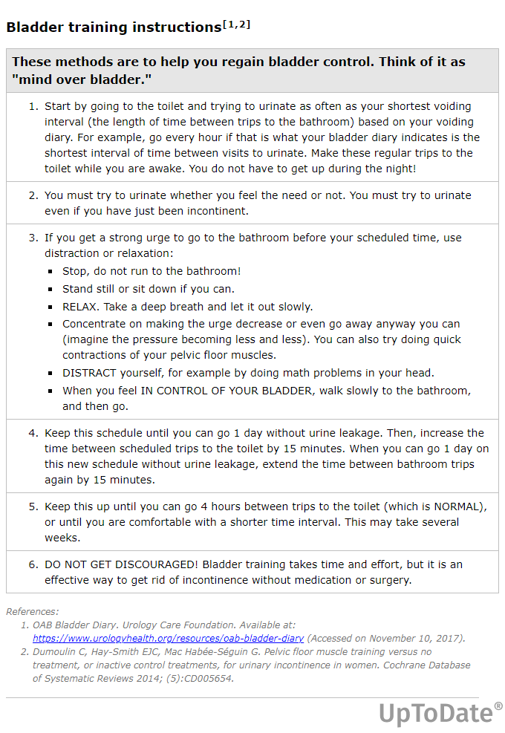
Bladder Training
Frequent voluntary voiding that at short intervals at first, and then spaced out
Use of urge suppression
Success may take months!
Prompted voiding can be done in patients with cognitive impairment

Slide 10
Pharmacologic management
UUI/ OAB
Mirabegron and Vibegron (B3 agonists) stimulate detrusor relaxation, ↑ bladder capacity
  Dosing 25 -50mg/day, no cognition concerns
Antimuscarinic agents (oxybutynin, tolterodine, trospium darefinacin)
  CI in patients with urinary retention, impaired gastric emptying, glaucoma
  Adverse effects: dry mouth and constipation, concerns for cognitive effects
  Darifenacin and trospium are purported to not cross BBB
SUI
Duloxetine (off label) use

Slide 11
Minimally Invasive Procedures
Primarily for refractory UUI
Percutaneous tibial nerve stimulation
  Acupuncture like needle behind ankle, stimulates tibial nerve for 30 minutes. 1/week for 12 weeks followed by maintenance tx 1/month
  Activating tibial nerve improves bladder control
Botox injections
  Performed under local anesthesia in office setting, effects last 3-12 mo, transiently increases risk of urinary retention
Sacral neuromodulation
  Implantable, programmable electrode that stimulates sacral nerve (pacemaker like, can be MRI compatible)
Catheters are not indicated for treatment of UI! (short term decompression for acute retention)

Slide 12
Surgery (5)
  Highest cure rates for stress UI in women
  Most common:
    Colposuspension (Burch operation)
    Slings (midurethral and bladder neck)
  Periurethral injection of a bulking agent for short term (≤1 year)
  Artificial sphincters for refractory stress incontinence from sphincter damage (eg, after radical prostatectomy)

Slide 13
Sources
Anger, Jennifer Tash et al. “The prevalence of urinary incontinence among community dwelling adult women: results from the National Health and Nutrition Examination Survey.” The Journal of urologyvol. 175,2 (2006): 601-4. doi:10.1016/S0022-5347(05)00242-9
Thom, D. “Variation in estimates of urinary incontinence prevalence in the community: effects of differences in definition, population characteristics, and study type.” Journal of the American Geriatrics Society vol. 46,4 (1998): 473-80.
Huang, Pan et al. “Urinary Incontinence Is Associated With Increased All-Cause Mortality in Older Nursing Home Residents: A Meta-Analysis.” Journal of nursing scholarship : an official publication of Sigma Theta Tau International Honor Society of Nursing vol. 53,5 (2021): 561-567. doi:10.1111/jnu.12671
Subak, Leslee L et al. “Weight loss to treat urinary incontinence in overweight and obese women.” The New England journal of medicine vol. 360,5 (2009): 481-90. doi:10.1056/NEJMoa0806375
Geriatric Review Syllabus Teaching Slides, Urinary Incontinence, Slide 45

