Slide 1

Constipation
Angelica Suarez-Ramirez, MD
Geriatric Medicine Fellow

Slide 2
case
82yo female is admitted to SBH for catatonia, had been worsening for a few days. After being in the hospital for 4 days staff alerts you she hasn’t had a bowel movement since she’s been here. What will you do?
  A. start docusate
  B. start miralax
  C. monitor

Slide 3
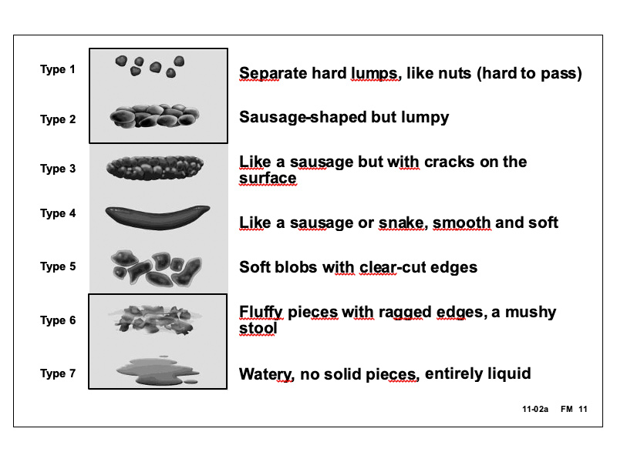
Learning objectives
Identify why constipation is a problem in geriatric population
Be able to define chronic constipation
Discuss management and treatment options
Discuss acute constipation as it relates to the inpatient setting
Bristol stool form scale

Slide 4
Why it matters
prevalence of constipation in the older adult ranges from 24-50%
Laxatives are used daily by 10-18% of community dwelling older adults and 74% of nursing home residents
Defecation may be impaired by decreased smooth muscle contraction in the rectum or the inability to relax the muscles of defecation. In older adults, rectal receptors may have a diminished response to stretching, blunting the urge to defecate despite accumulation of large quantities of stool.
Inpatient: In elderly patients who may be confused, constipation may manifest as dehydration or nausea and may result in fecal impaction or bowel obstruction. This can result in delirium, increased length of stay in hospital, and increased morbidity and mortality

Slide 5
Rome iv criteria
Criteria fulfilled for the last 3 months with symptom onset at least 6 months prior to diagnosis. Must include two or more of the following:**
Straining during more than ¼ (25%) of defecations
Lumpy or hard stools (Bristol Stool Form Scale 1-2) more than ¼ (25%) of defecations
Sensation of incomplete evacuation more than ¼ (25%) of defecations
Sensation of anorectal obstruction/blockage more than ¼ (25%) of defecations
Manual maneuvers to facilitate more than ¼ (25%) of defecations (e.g., digital evacuation, support of the pelvic floor)
Fewer than three SBM per week
Loose stools are rarely present without the use of laxatives
Insufficient criteria for irritable bowel syndrome

Slide 6
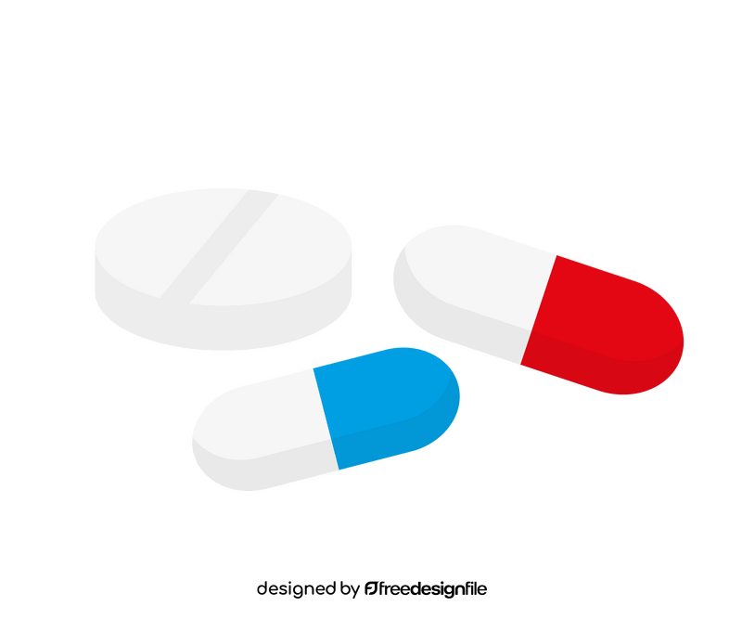




causes

Slide 7
workup
Exclude secondary causes
immobility, chronic medical problems, medication list
Concurrent psychosocial problems such as social isolation, decreased mobility, poor nutrition, and lack of independence should also be addressed as they can contribute to constipation
in patients with chronic constipation without alarm symptoms or signs (hematochezia, weight loss ≥10 pounds, family history of colon cancer or inflammatory bowel disease, anemia, positive fecal occult blood tests, acute onset of constipation in older adults, and severe persistent constipation that is unresponsive to treatment), there are inadequate data to make a recommendation about the routine use of laboratory test

Slide 8
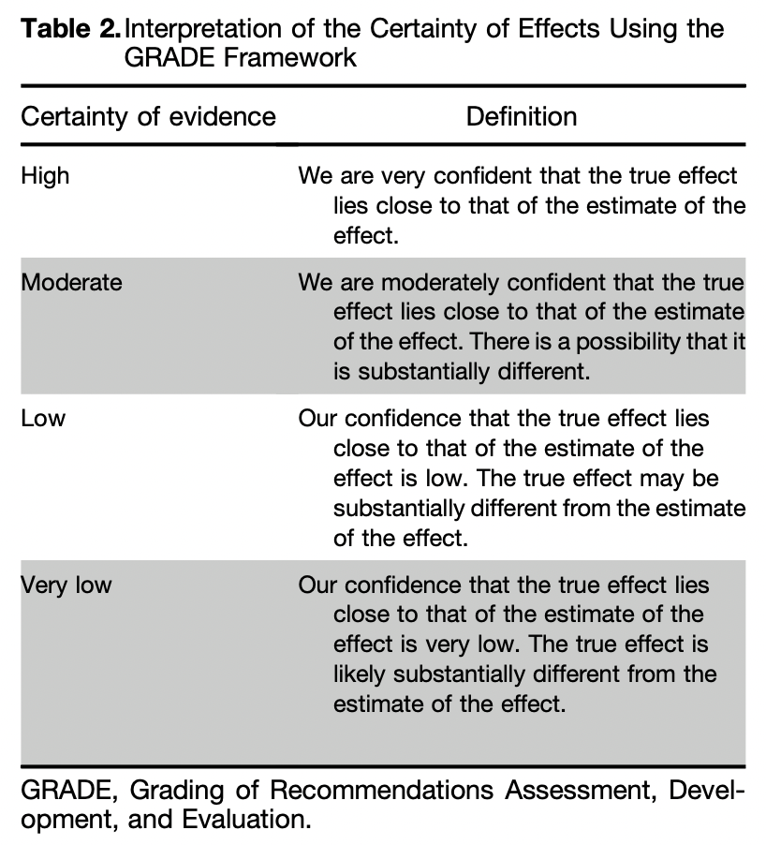
Treatment
Step 1: try non-pharmacologic. Increase fluid and fiber intake. Exercise. Scheduled toileting after meals
Step 2: Meds

Slide 9
Treatment cont.
Fiber: Among the evaluated fiber supplements, only psyllium appears to be effective (with very limited and uncertain data on bran and inulin)
Osmotic agents:
  Polyethylene glycol (miralax)- strong rec, mod evidence. Side effects include abdominal distension, loose stool, flatulence, and nausea
  Magnesium oxide- conditional, very low. Avoid use in patients with renal insufficiency due to risk of hypermagnesemia
  Lactulose- conditional, very low. Bloating and flatulence are dose-dependent and common side effects, which may limit its use in clinical practice
Stimulant laxatives
  Bisacodyl or sodium picosulphate short term or as rescue therapy. Strong, mod.
    Short-term use is defined as daily use for 4 wk or less. While long- term use is probably appropriate, data are needed to better understand tolerance and side effects
    good option for occasional use or rescue therapy in combination
    most common side effects are abdominal pain, cramping and diarrhea
  Senna. Conditional, low. Abdominal pain and cramping may occur with a higher dose of senna

Slide 10
Treatment cont.
Secretagogues
  Lubiprostone. Conditional, low. Nausea may occur; however, the risk of nausea is dose-dependent and seems to be lower when taken with food and water
  Linaclotide and Plecanatide. Strong, mod. Duration of treatment in trials was 12 wk but the drug label does not provide a limit. May be associated with side effects of diarrhea leading to discontinuation of treatment
5HT4 agonist
  Prucalopride. Strong, mod. Duration of treatment in trials was 4–24 wk but the drug label does not provide a limit. May be associated with side effects of headache, abdominal pain, nausea, and diarrhea

Slide 11
Opioid induced constipation
Peripherally Acting µ-Opioid Receptor Antagonists
  Naldemedine- should be avoided in combination with medications that inhibit CYP3A4
  Naloxegol- can be crushed for enteral tube administration or for patients with swallowing difficulties
  methylnaltrexone - available as a tablet or subcutaneous injection
use of PAMORAs in clinical practice may be limited due to the higher cost of these drugs
Abdominal pain, diarrhea, and nausea are the most common adverse effects
Alvimopan is indicated specifically for postoperative ileus

Slide 12
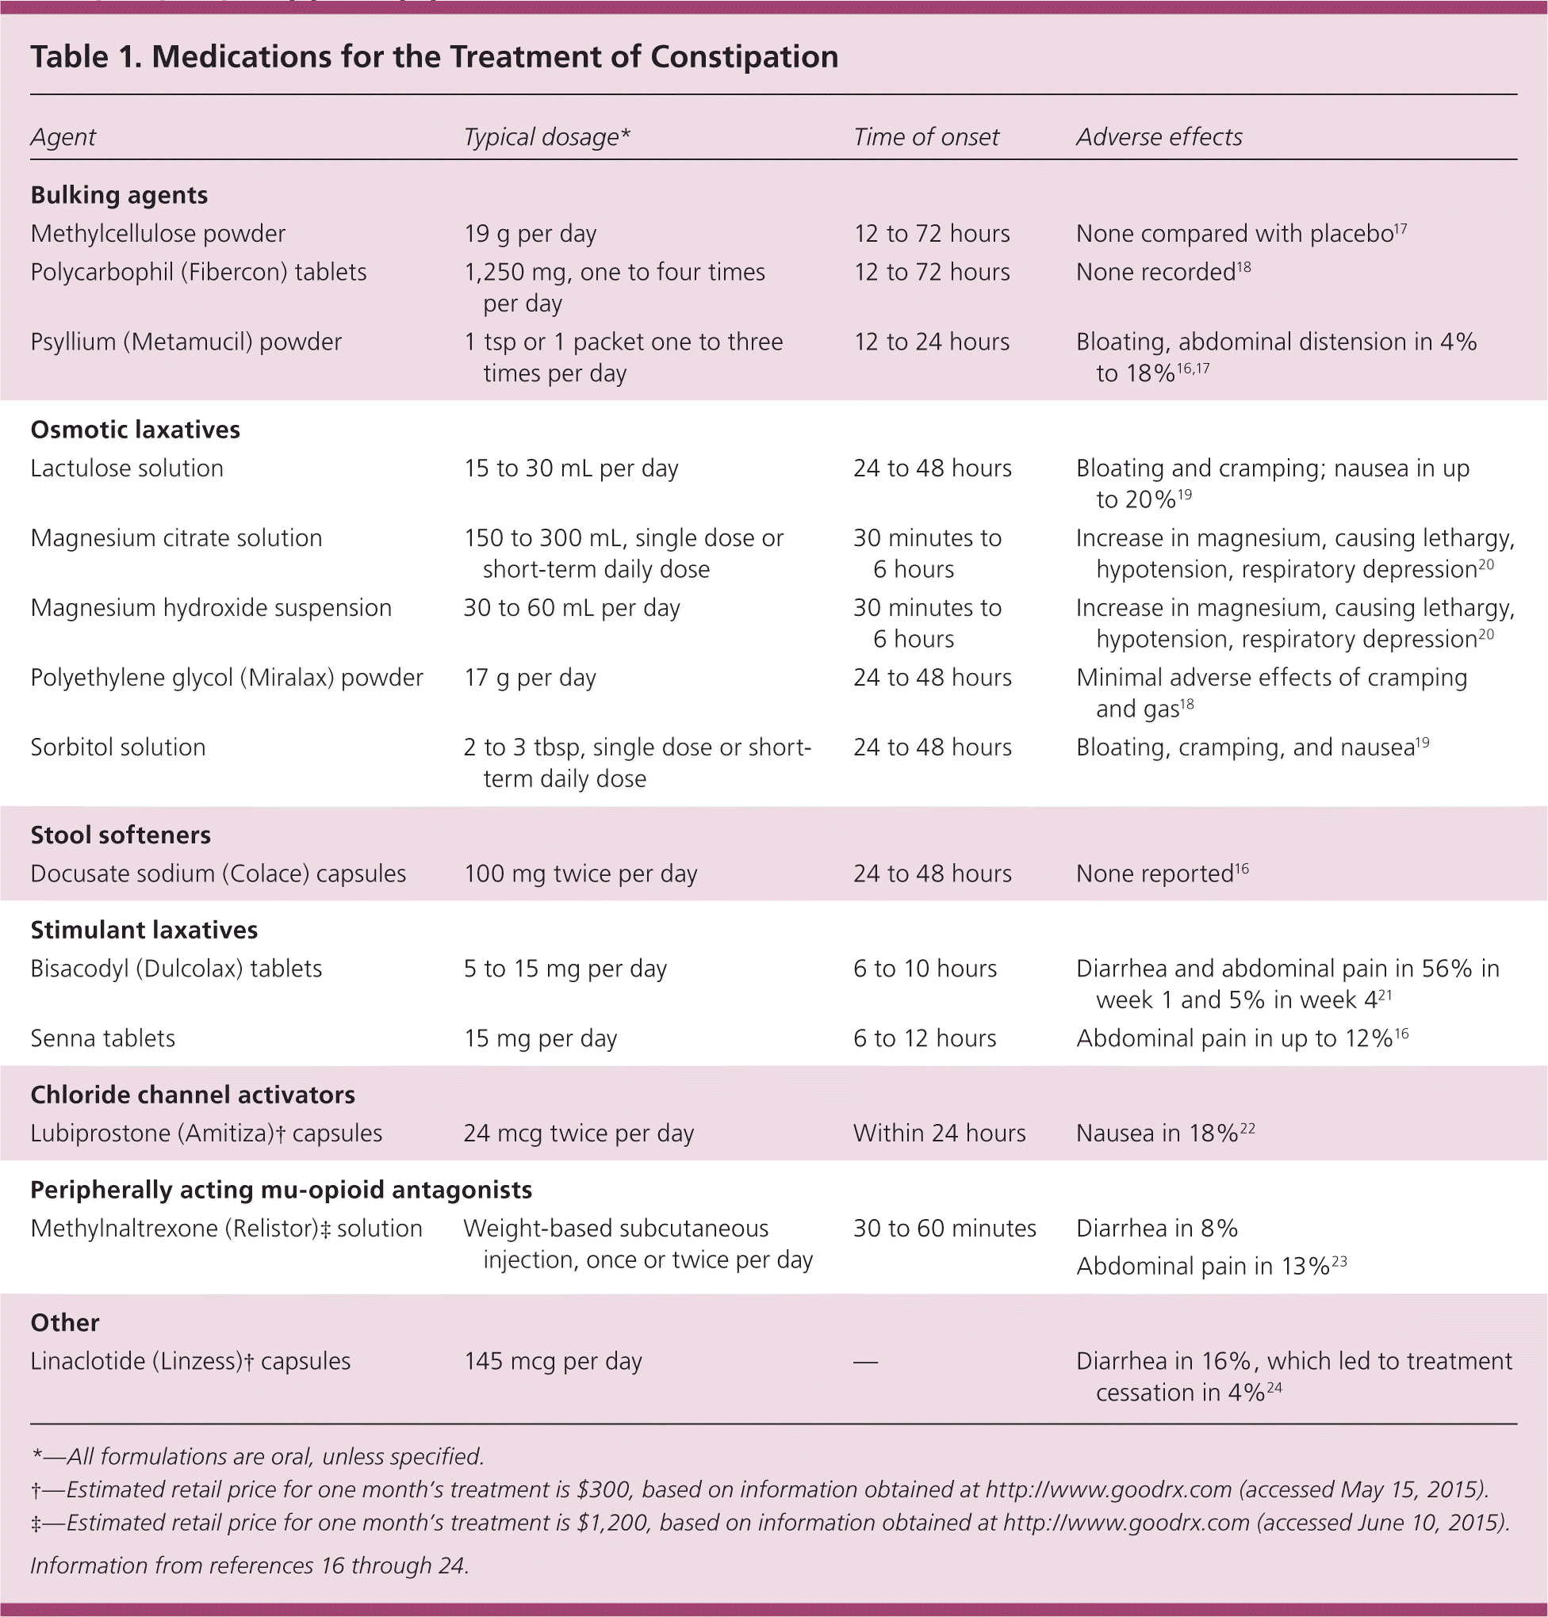

Slide 13
Acute constipation
Rome IV Criteria not intended for hospitalized patients
decreased frequency of bowel movements (BMs) during hospitalization versus preadmission, extended times between BMs (e.g., <3 per week), and/or stools that are excessively hard and difficult to pass
Supine AP images of the abdomen and pelvis (kidney, ureter, and bladder X-ray) can help assess the burden of feces, colon diameter, and evidence of colonic obstruction.
Upright and lateral decubitus images can help assess for complications of constipation (e.g., perforation-associated intraperitoneal air)
abdominal CT ideally should be performed with intravenous or positive oral contrast to optimize evaluation of the bowel wall for masses, ischemia, or inflammation

Slide 14
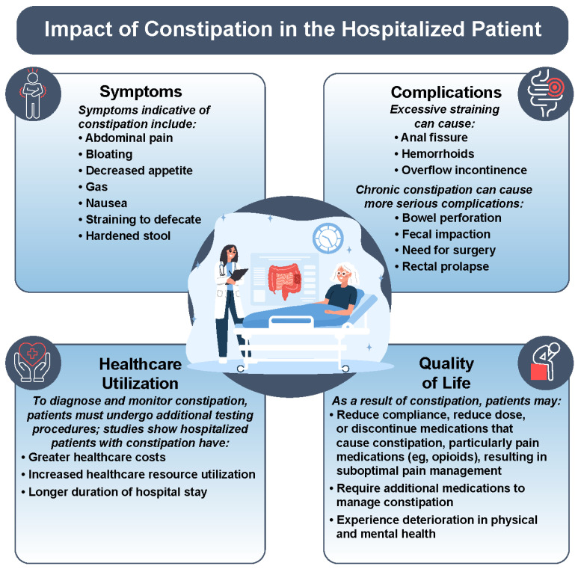

Slide 15
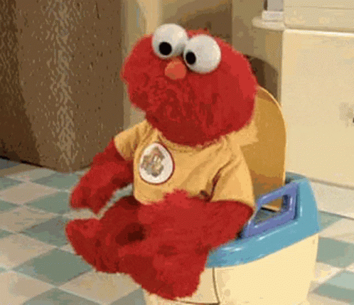
Thank you

Slide 16
resources
American Gastroenterological Association-American College of Gastroenterology Clinical Practice Guideline: Pharmacological Management of Chronic Idiopathic Constipation. Chang, Lin et al. Gastroenterology, Volume 164, Issue 7, 1086 – 1106
Sayuk GS, Yu QT, Shy C. Management of Constipation in Hospitalized Patients. Journal of Clinical Medicine. 2023; 12(19):6148. https://doi.org/10.3390/jcm12196148
UpToDate

